Slide 1
9
9
14
Creational patterns
Structural patterns
Behavior patterns
Abstract factory
Adapter or Wrapper or Translator.
Blackboard
Builder
Bridge
Chain of responsibility
Command
Factory method
Composite
Interpreter
Lazy initialization
Decorator
Iterator
Multiton
Facade
Mediator
Memento
Object pool
Front Controller
Null object
Prototype
Module
Observer or Publish/subscribe
Resource acquisition is initialization
Proxy
Servant
State
Singleton
Twin
Strategy
Architectural Patterns
Template method
Other Patterns
Visitor

Slide 2
Creational patterns
Pattern Name - Increases vocabulary of designers
Problem - Intent, context, when to apply
Solution - UML-like structure, abstract code
Consequences - Results and tradeoffs
Deal with initializing and configuring classes and objects
Deal with object creation mechanisms
Trying to create objects in a manner suitable to the situation
Composed of two dominant ideas
Encapsulating knowledge about which concrete classes the system uses
Hiding how instances of these concrete classes are created and combined

Slide 3

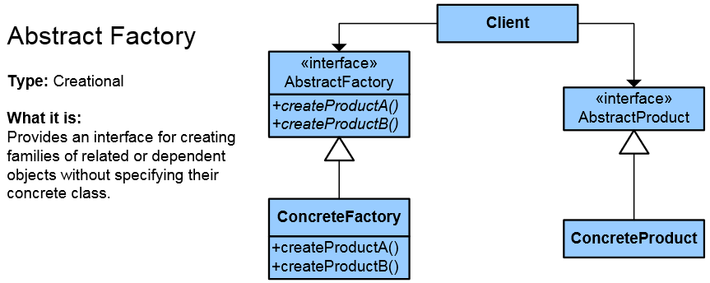
Abstract factory
Abstraction in object creation
Create a family of related
objects
The Abstract Factory Pattern defines
interface for creating sets of linked objects
Without knowing their concrete classes
Used in systems that are frequently changed
Provides flexible mechanism for replacement of different sets
Demo от академията : примера е с приложение което прави Пици.
Създаваме обекти които зависят един от друг.
Има няколко класа с различни пици.
1.Абстрактната фабрика се състои от три метода всеки от които прави определена пица.
2.Този клас се наследява от двата производители на пици, които олвърлолдват методите и добавят своите съставки към различните пица
3.Така ако се наложи добавяне на нов производител или нова пица бързо и лесно се добавят тези функционалности

Slide 4
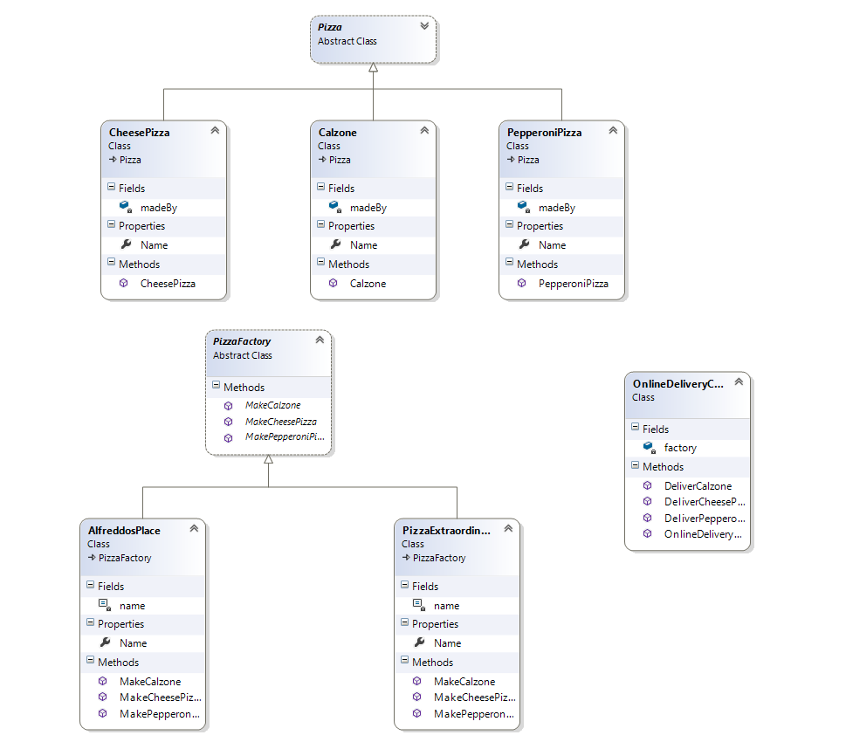
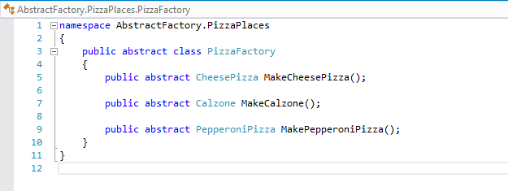
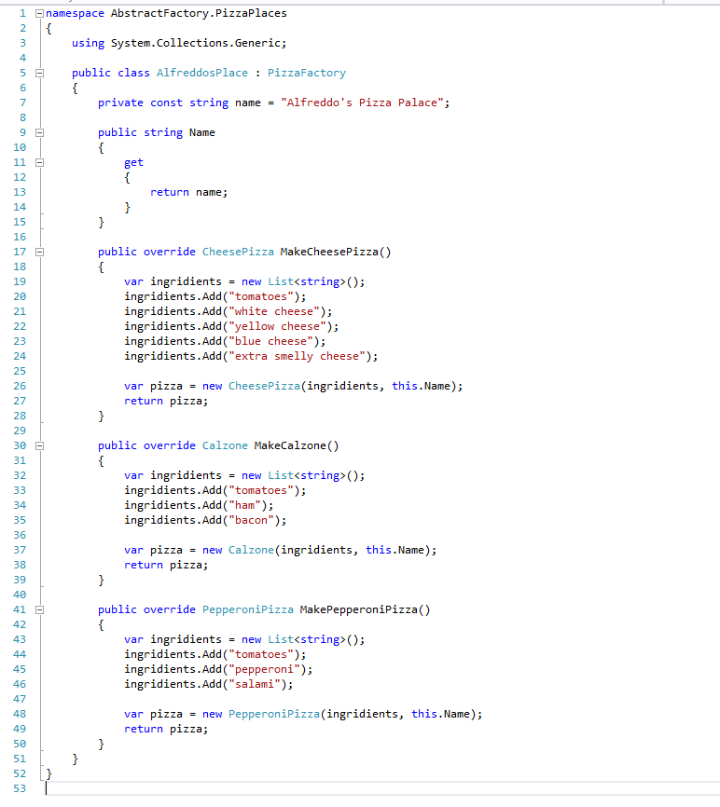
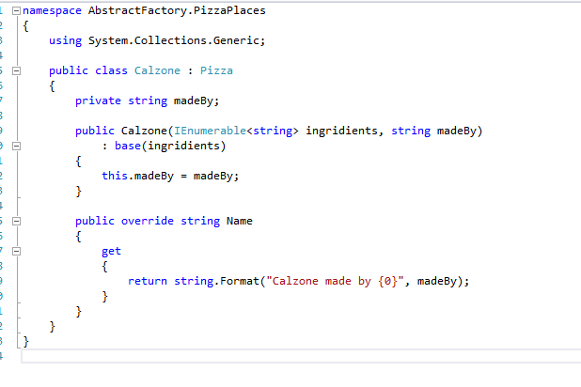
Abstract factory

Slide 5
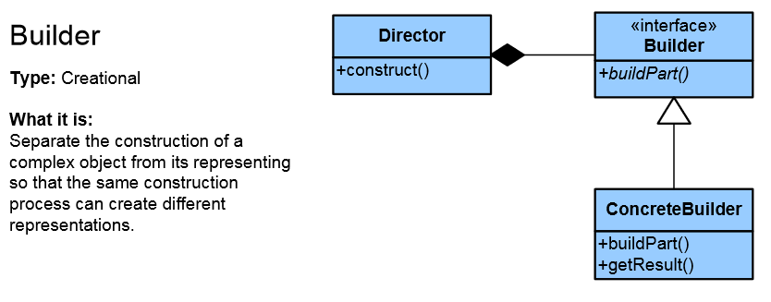
Builder
Separates the construction of a complex object
from its representation so that the same
construction process can create
different representations
Separation of logic and data
Solves 3 types of problems
Too many parameters
Order dependent
Different constructions
Put the steps in the right order
Director
Defines the implementation
Define the steps
Builder
Concrete Builder
Product
Много е подходящ когато имаме много параметри в обектите
Изпозва се при постъпкови операции пример Subway . Сандвичите се правят като последователно се поставят различни съставки

Slide 6
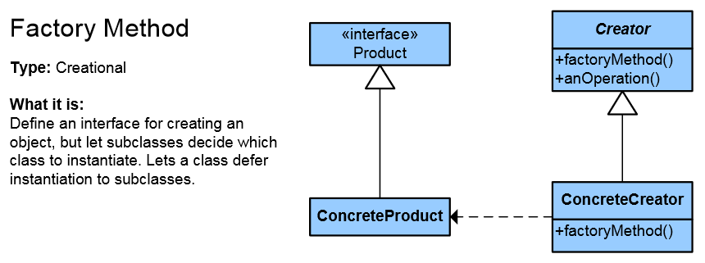
Factory method
Objects are created by separate method
Produces objects as normal Factory
This allows achieving higher reusability and flexibility in the changing applications
Създава обеки .
Всеки обект се създава от различна фунция
Някой наследник на фабриката може да имплементира фунционалност и да определеи как създаденото нещо се използва

Slide 7
Pattern Name - Increases vocabulary of designers
Problem - Intent, context, when to apply
Solution - UML-like structure, abstract code
Consequences - Results and tradeoffs
Structural patterns
Describe ways to assemble objects to implement a new functionality
Composition of classes or objects
Describe ways to assemble objects to implement a new functionality
Ease the design by identifying a simple way to realize relationships between entities
This design patterns is all about Class and Object composition
Structural class-creation patterns use inheritance to compose interfaces
Structural object-patterns define ways to compose objects to obtain new functionality

Slide 8
Behavior patterns
Pattern Name - Increases vocabulary of designers
Problem - Intent, context, when to apply
Solution - UML-like structure, abstract code
Consequences - Results and tradeoffs
Deal with dynamic interactions among societies of classes and objects
How they distribute responsibility
Concerned with communication (interaction) between the objects
Either with the assignment of responsibilities between objects
Or encapsulating behavior in an object and delegating requests to it
Increase flexibility in carrying out cross-classes communication

